Slide 1
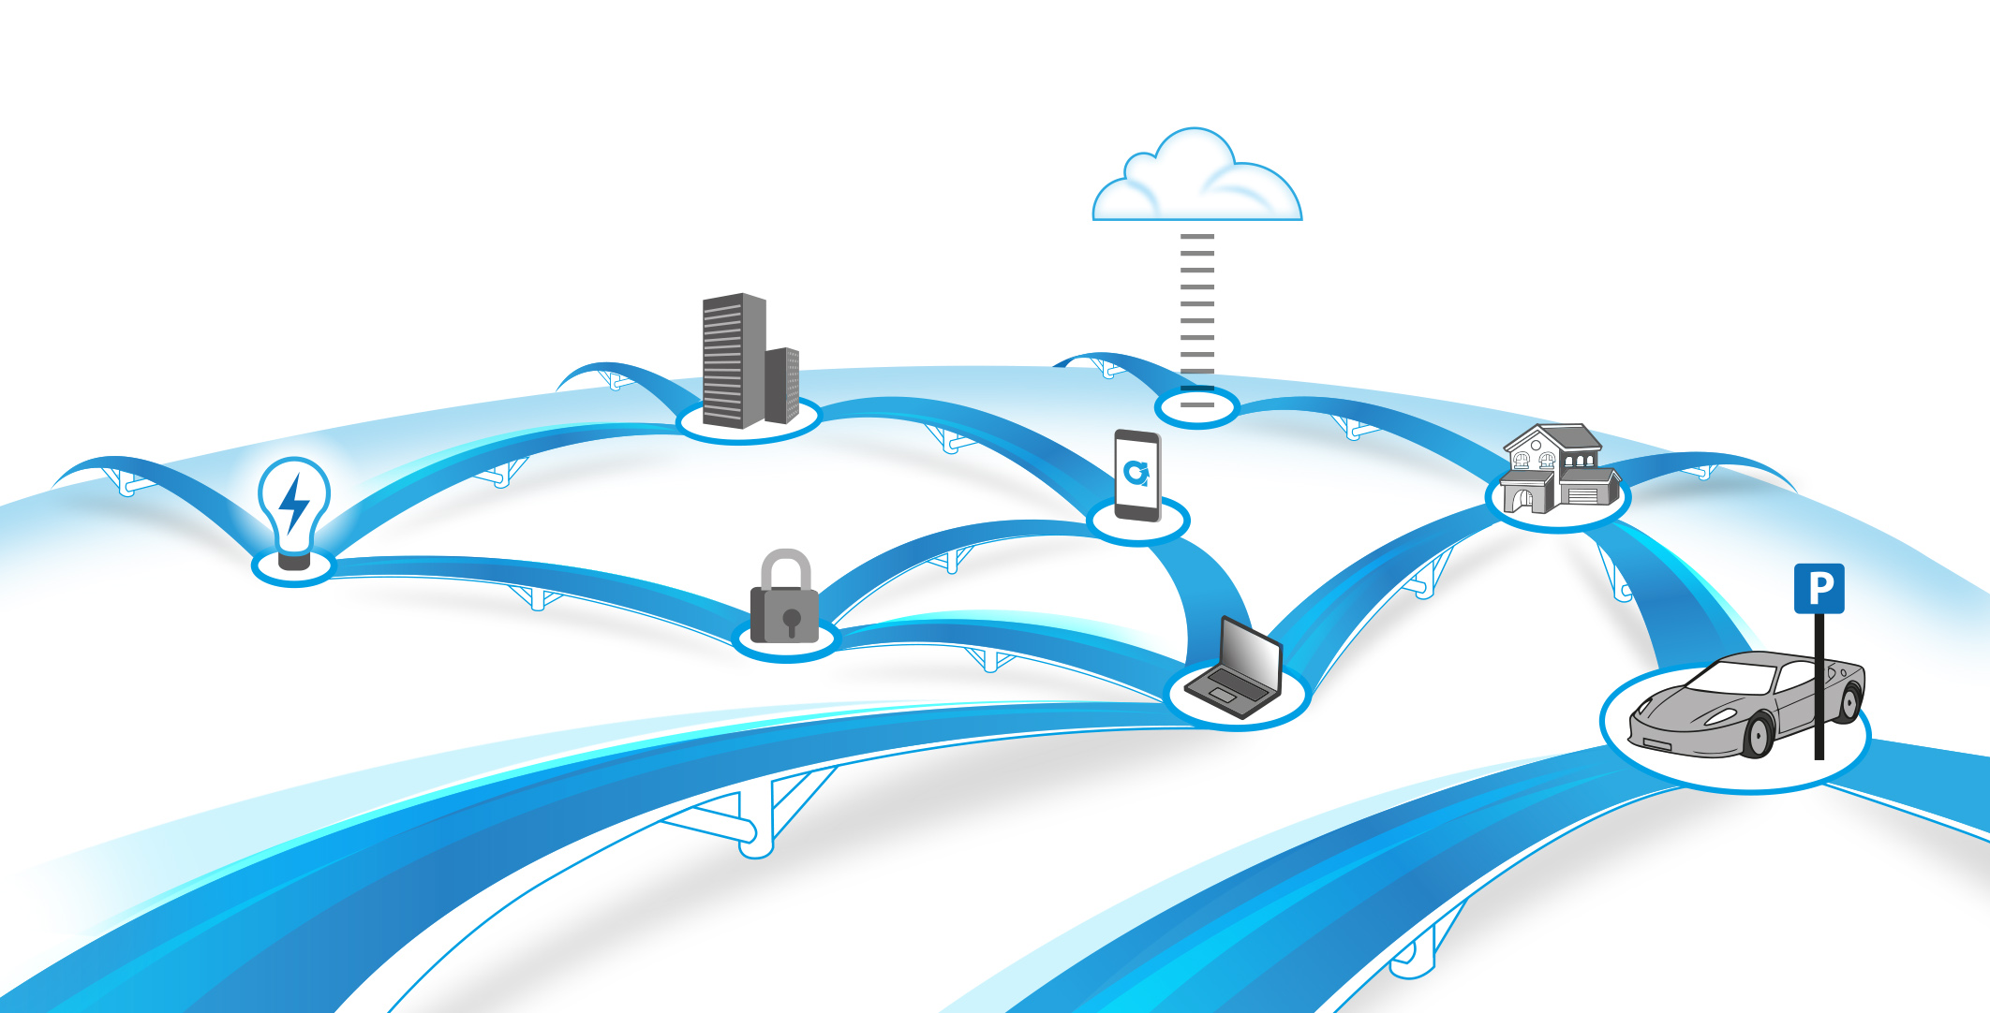
Altiux website – Product page

Slide 3
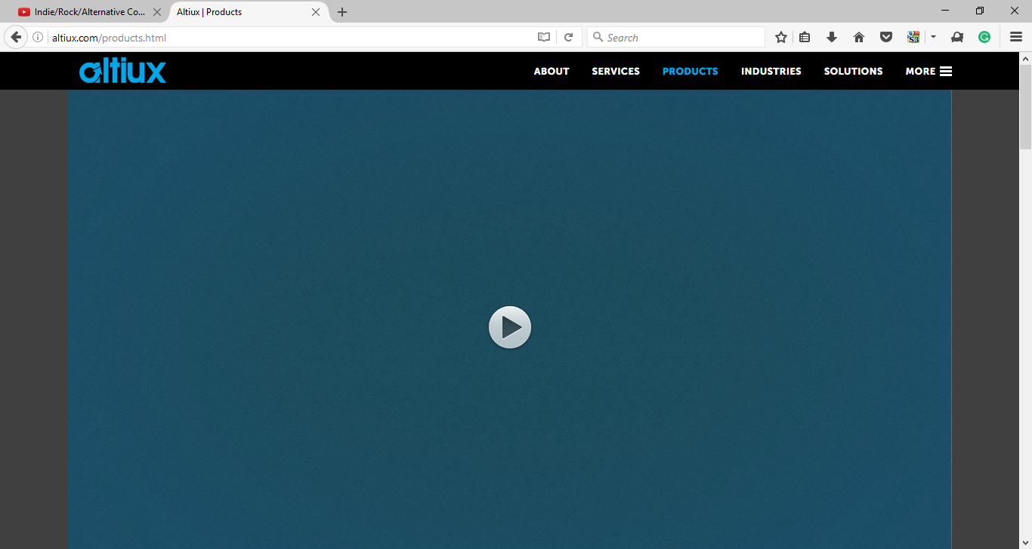
Product page link
Rename to ‘Toolkit’
REDUCE PROTOYPING TIME & ACCELERATE GO TO MARKET
Upto 50% reduction in prototyping efforts & upto 30% faster go to market
with ready to use, commercial grade and highly scalable framework
This video to be removed

Slide 4
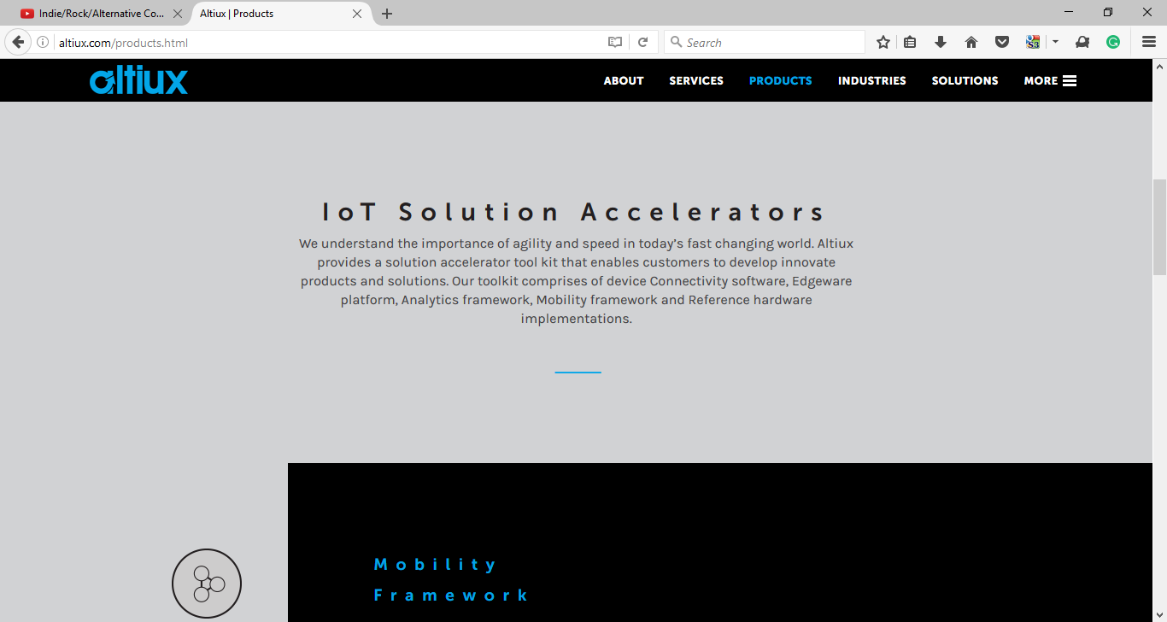
ToolKit Intro
CloudPlug & DeviceSocket )

Slide 5
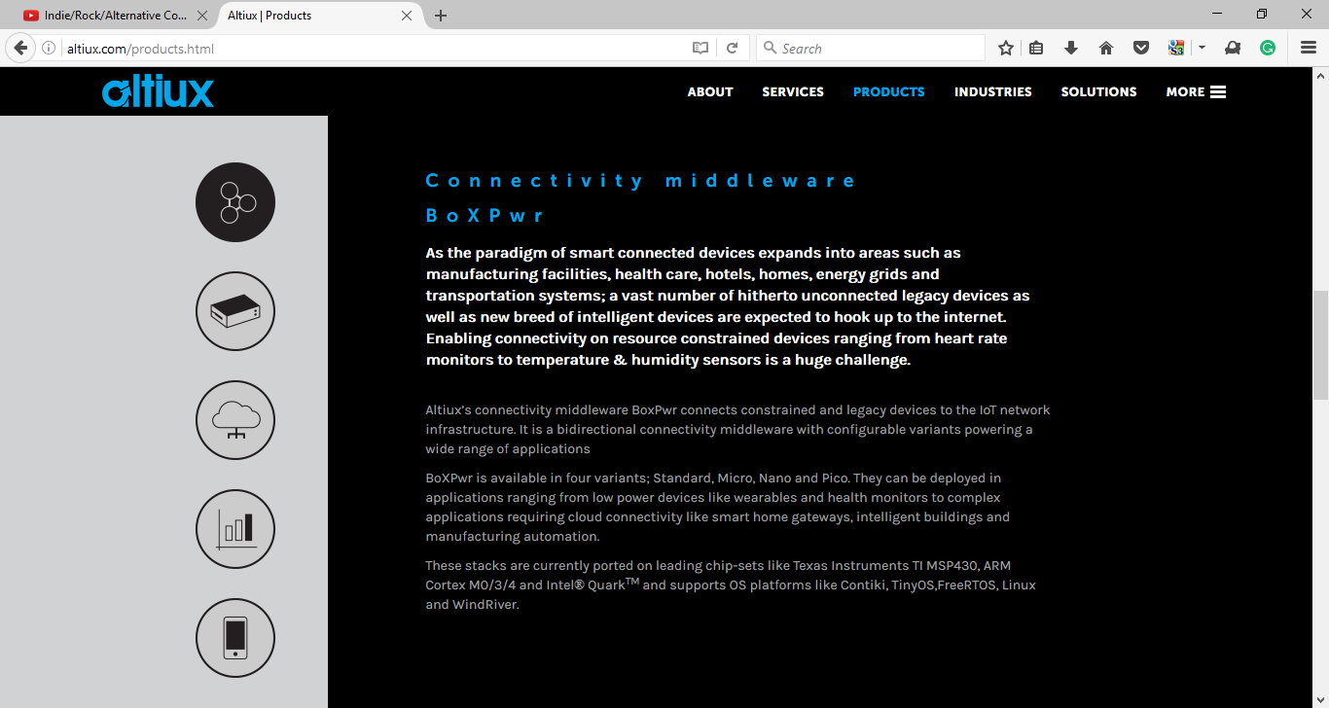



IoT Device framework
We can retain this icon →
BoxPwr - Altiux’s IoT device middleware framework BoxPwR is a customizable framework of software components that provides connectivity, security, manageability and value added features essential for IoT device & gateway development. It easily scales as per device requirement – from extremely low power, constrained devices to full-service IoT gateways. | DeviceSocket - Altiux’s IoT device management framework DeviceSocket is design to provide converged device management. It provides framework of components that can enable provisioning, registration, commissioning and FOTA of heterogenous devices. It comes with multi security modes and can also support Low Throughput Network like LoRa, Sigfox, etc. to provide unified device management. | CloudPlug - Altiux’s IoT multi cloud framework CloudPlug is a framework of components that enables multi-cloud connectivity. It is secure and highly available stack that can route any messages to any cloud, and even to multiple clouds simultaneously. It provides well defined secure APIs to develop cloud adapters and can be deployed on private, public or hybrid cloud.

Slide 6
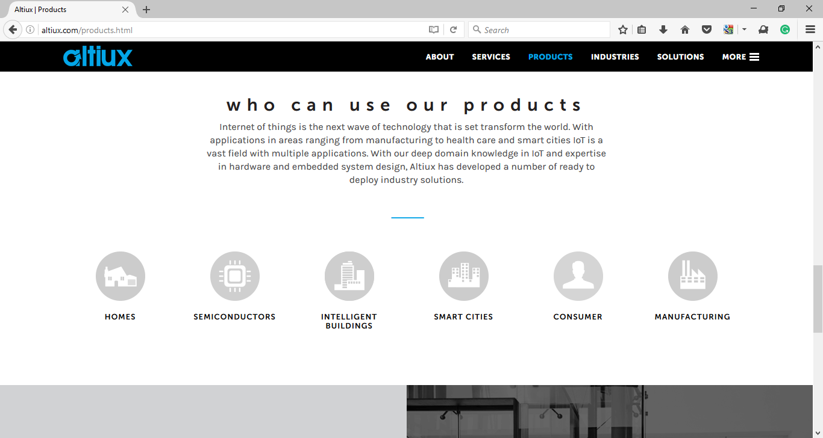




toolkit
SEMICONDUCTORS
OEMs
CSV, ISV
SI
Pre-integrate BoxPwr on chipsets which can be used for rapid prototyping and/or productising
BoxPwr configured hardware to develop complex use cases, closer to product requirements
Toolkit components can help deliver customized usage scenarios for customers
Toolkit components with our technology enablement services can offer differentiated solutions
Request a demo

Slide 7
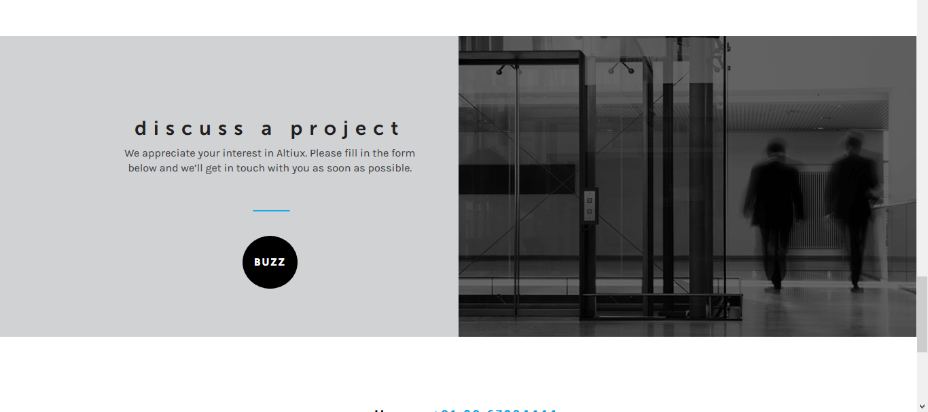
How can we collaborate
Partnership program Toolkit components packaged as ‘IOT Starter kits’ for quick prototyping and/or productising | Licencing program Pre-configured ready-to-use Toolkit variants to be used for solution development

Slide 9
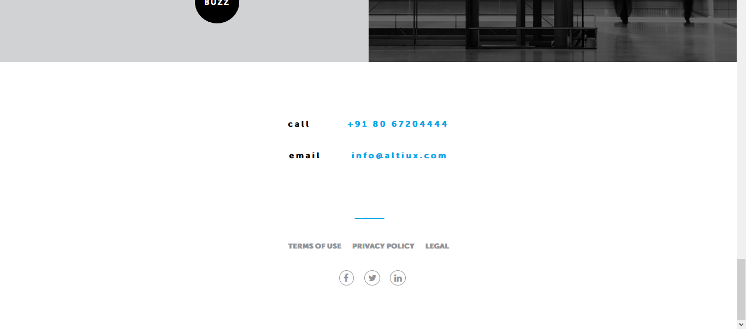

Slide 10



www.altiux.com
info@altiux.com
India | USA | Japan | Korea | Germany
IoT Frameworks | Product Engineering Services
a company

Slide 11
IoT Device framework
We can retain this icon →
BoxPwr - Altiux’s IoT device framework
BoxPwR, part of Altiux’s IoT Toolkit portfolio, is a customizable framework of software components that provides connectivity, security, manageability and value added features essential for IoT device & gateway development. It easily scales as per device requirement – from extremely low power, constrained devices to full-service IoT gateways.

Slide 12
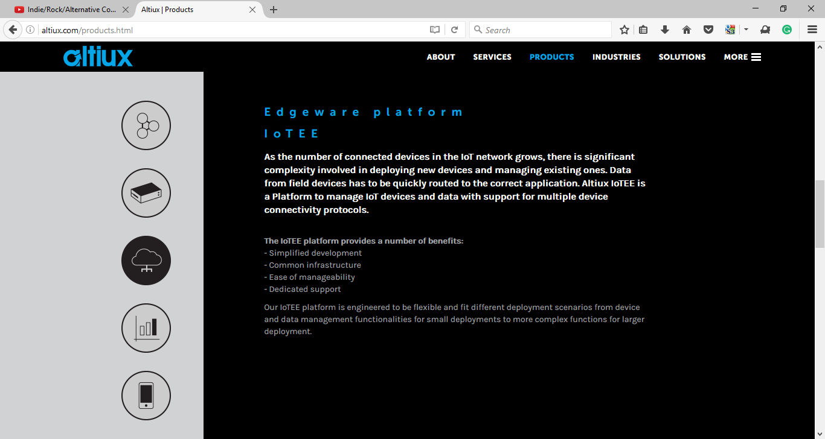
IoT Cloud edge framework
CloudPlug - Altiux’s IoT cloud edge framework
CloudPlug, part of Altiux’s IoT Toolkit portfolio, is a framework of components that enables multi cloud connectivity.
We can retain this icon →

Slide 13
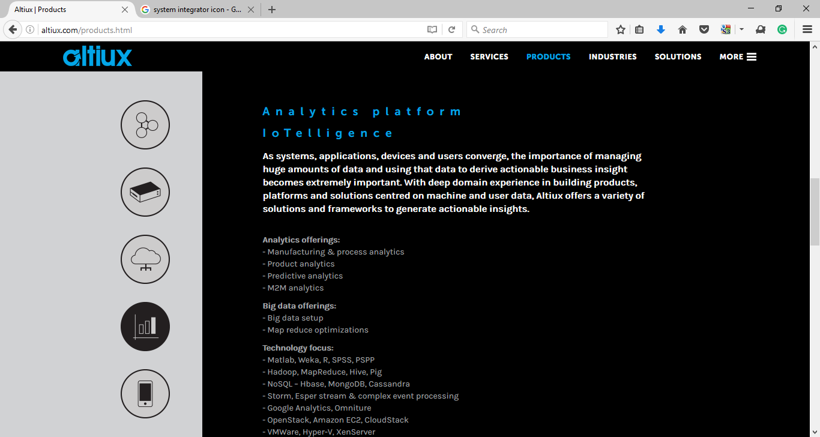

IoT Cloud edge framework
DevicePlug - Altiux’s IoT cloud edge framework
CloudPlug, part of Altiux’s IoT Toolkit portfolio, is a framework of components that enables converged device management. It can enable device management support like LWM2M, OMA DM, etc. can enable unified device management.

Slide 14

To be removed
To be removed
To be removed

Slide 15
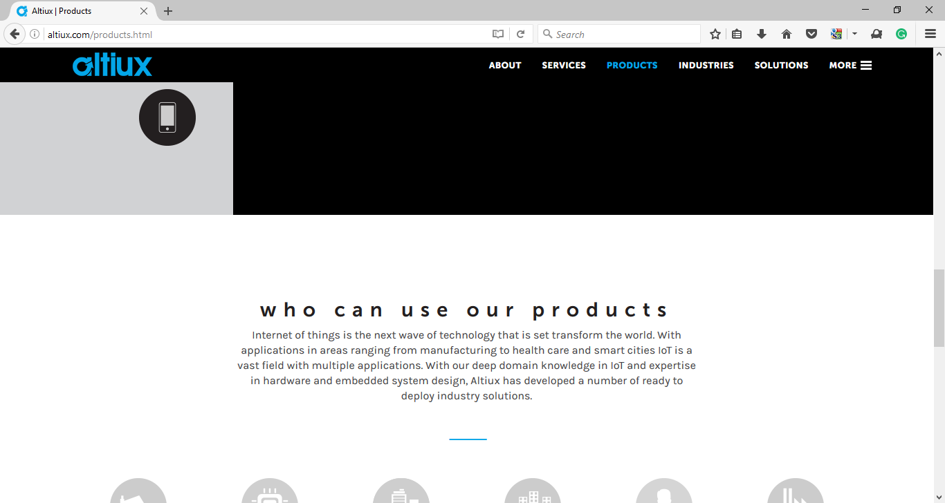
toolkit

